Slide 1
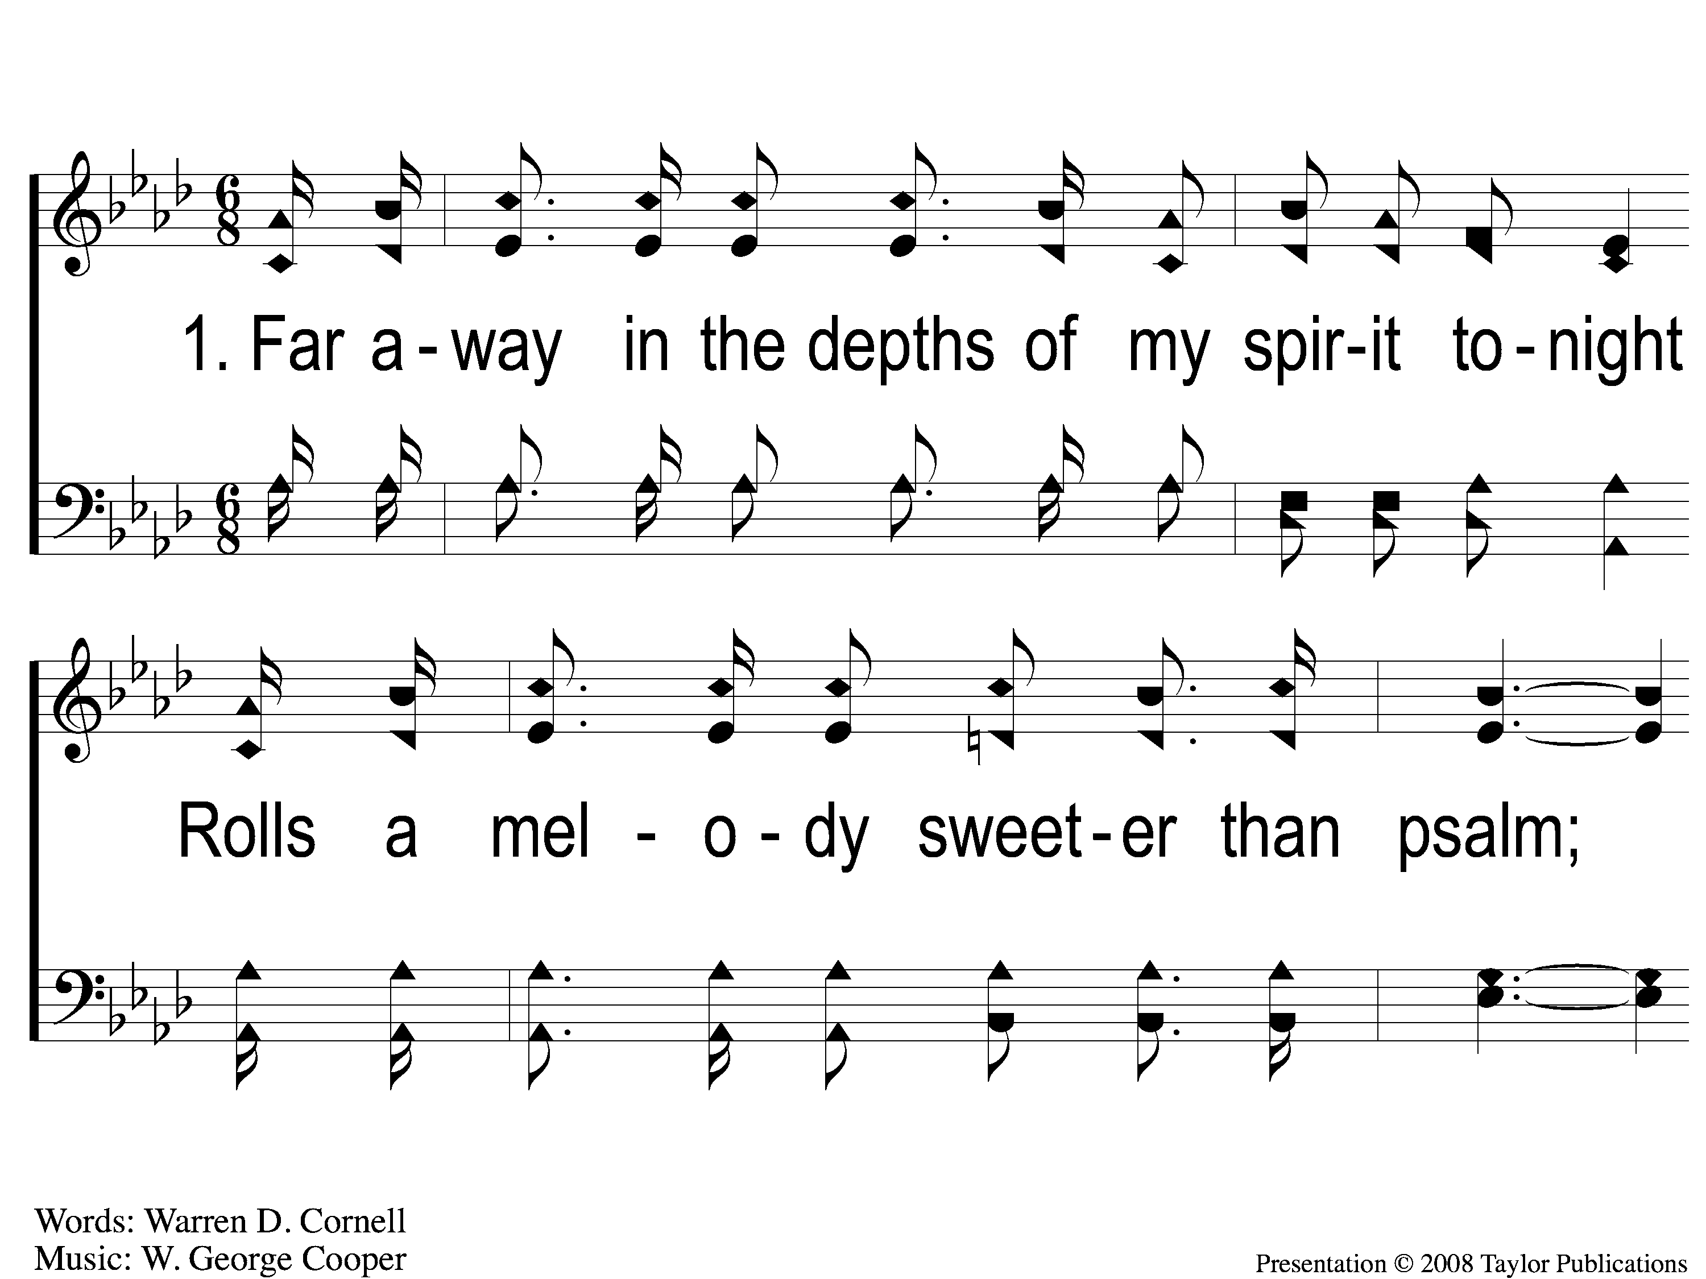
1-1 Far Away In The Depths
Far Away In The Depths
101

Slide 2
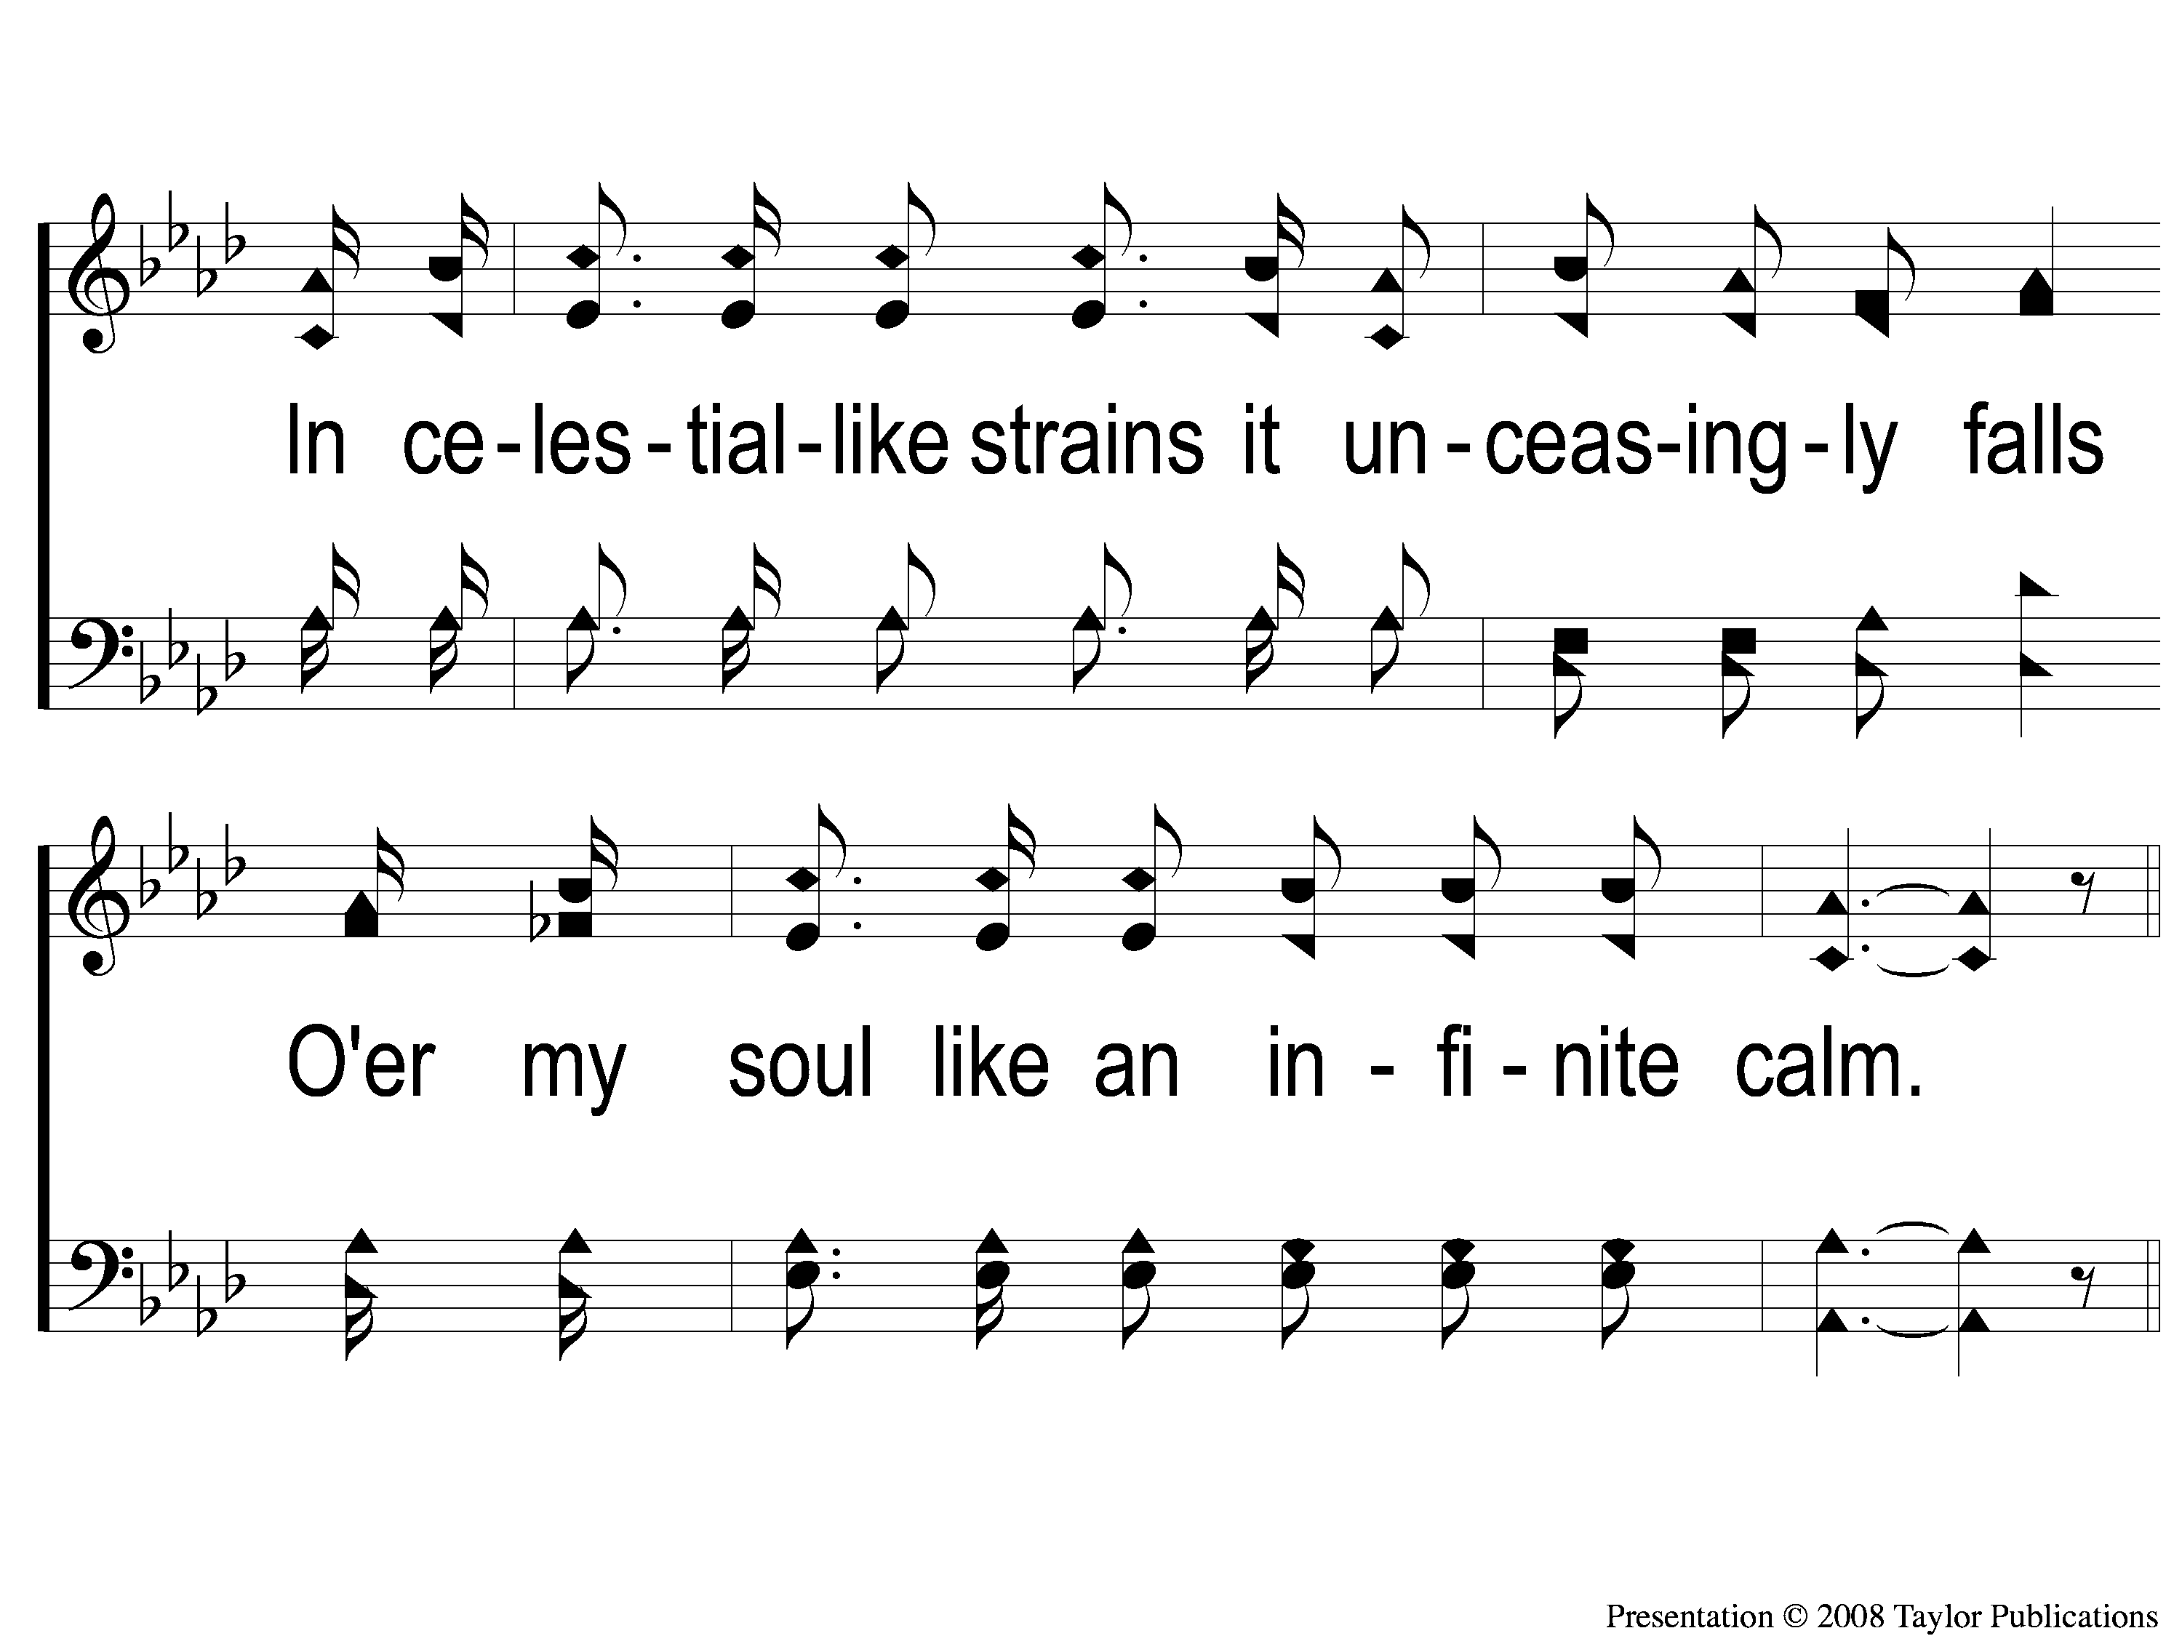
1-2 Far Away In The Depths
Far Away In The Depths
101

Slide 3
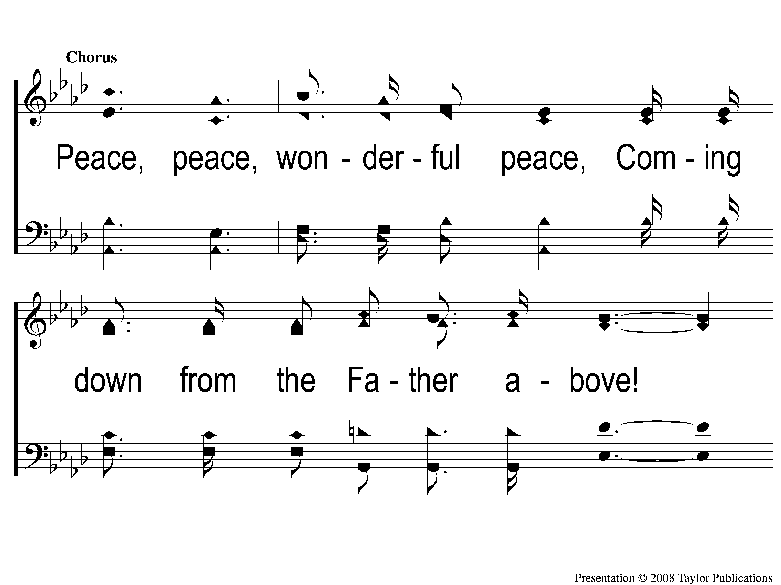
C-1 Far Away In The Depths
Far Away In The Depths
101

Slide 4
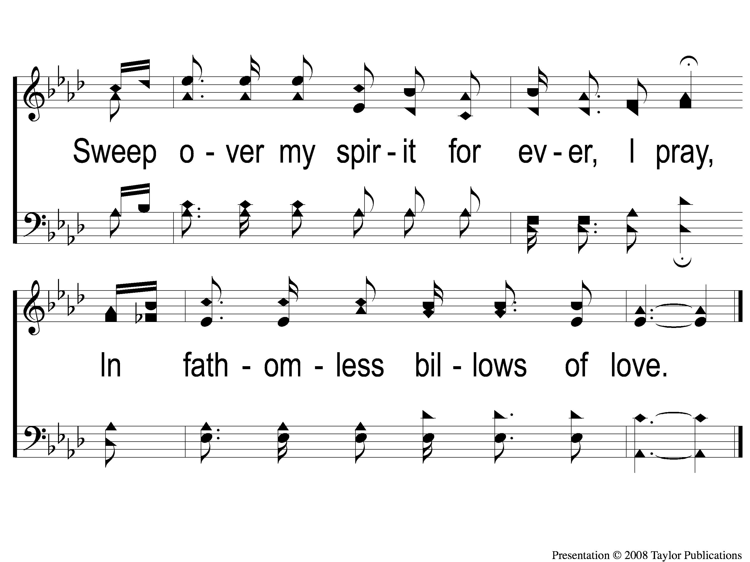
C-2 Far Away In The Depths
Far Away In The Depths
101

Slide 5
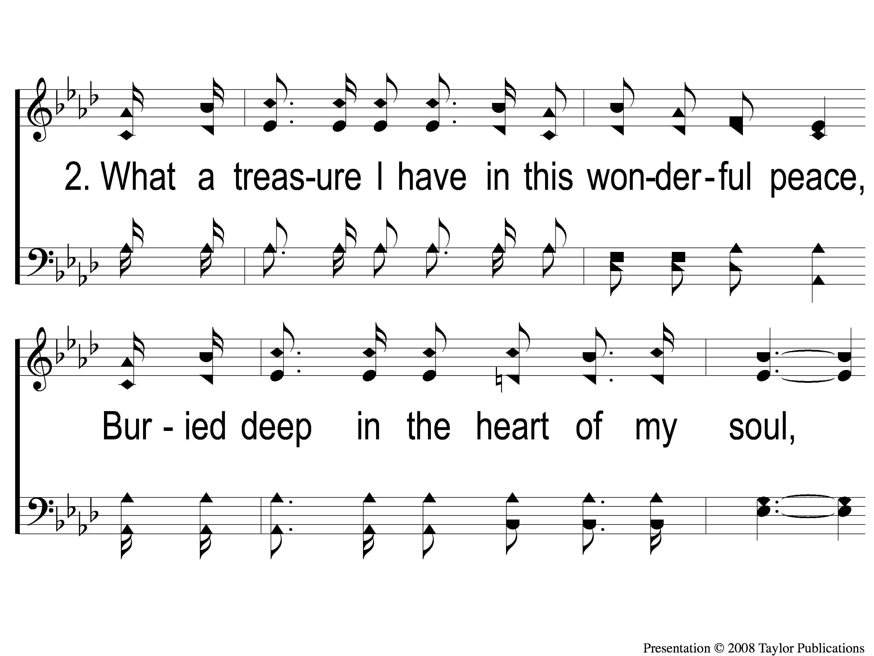
2-1 Far Away In The Depths
Far Away In The Depths
101

Slide 6
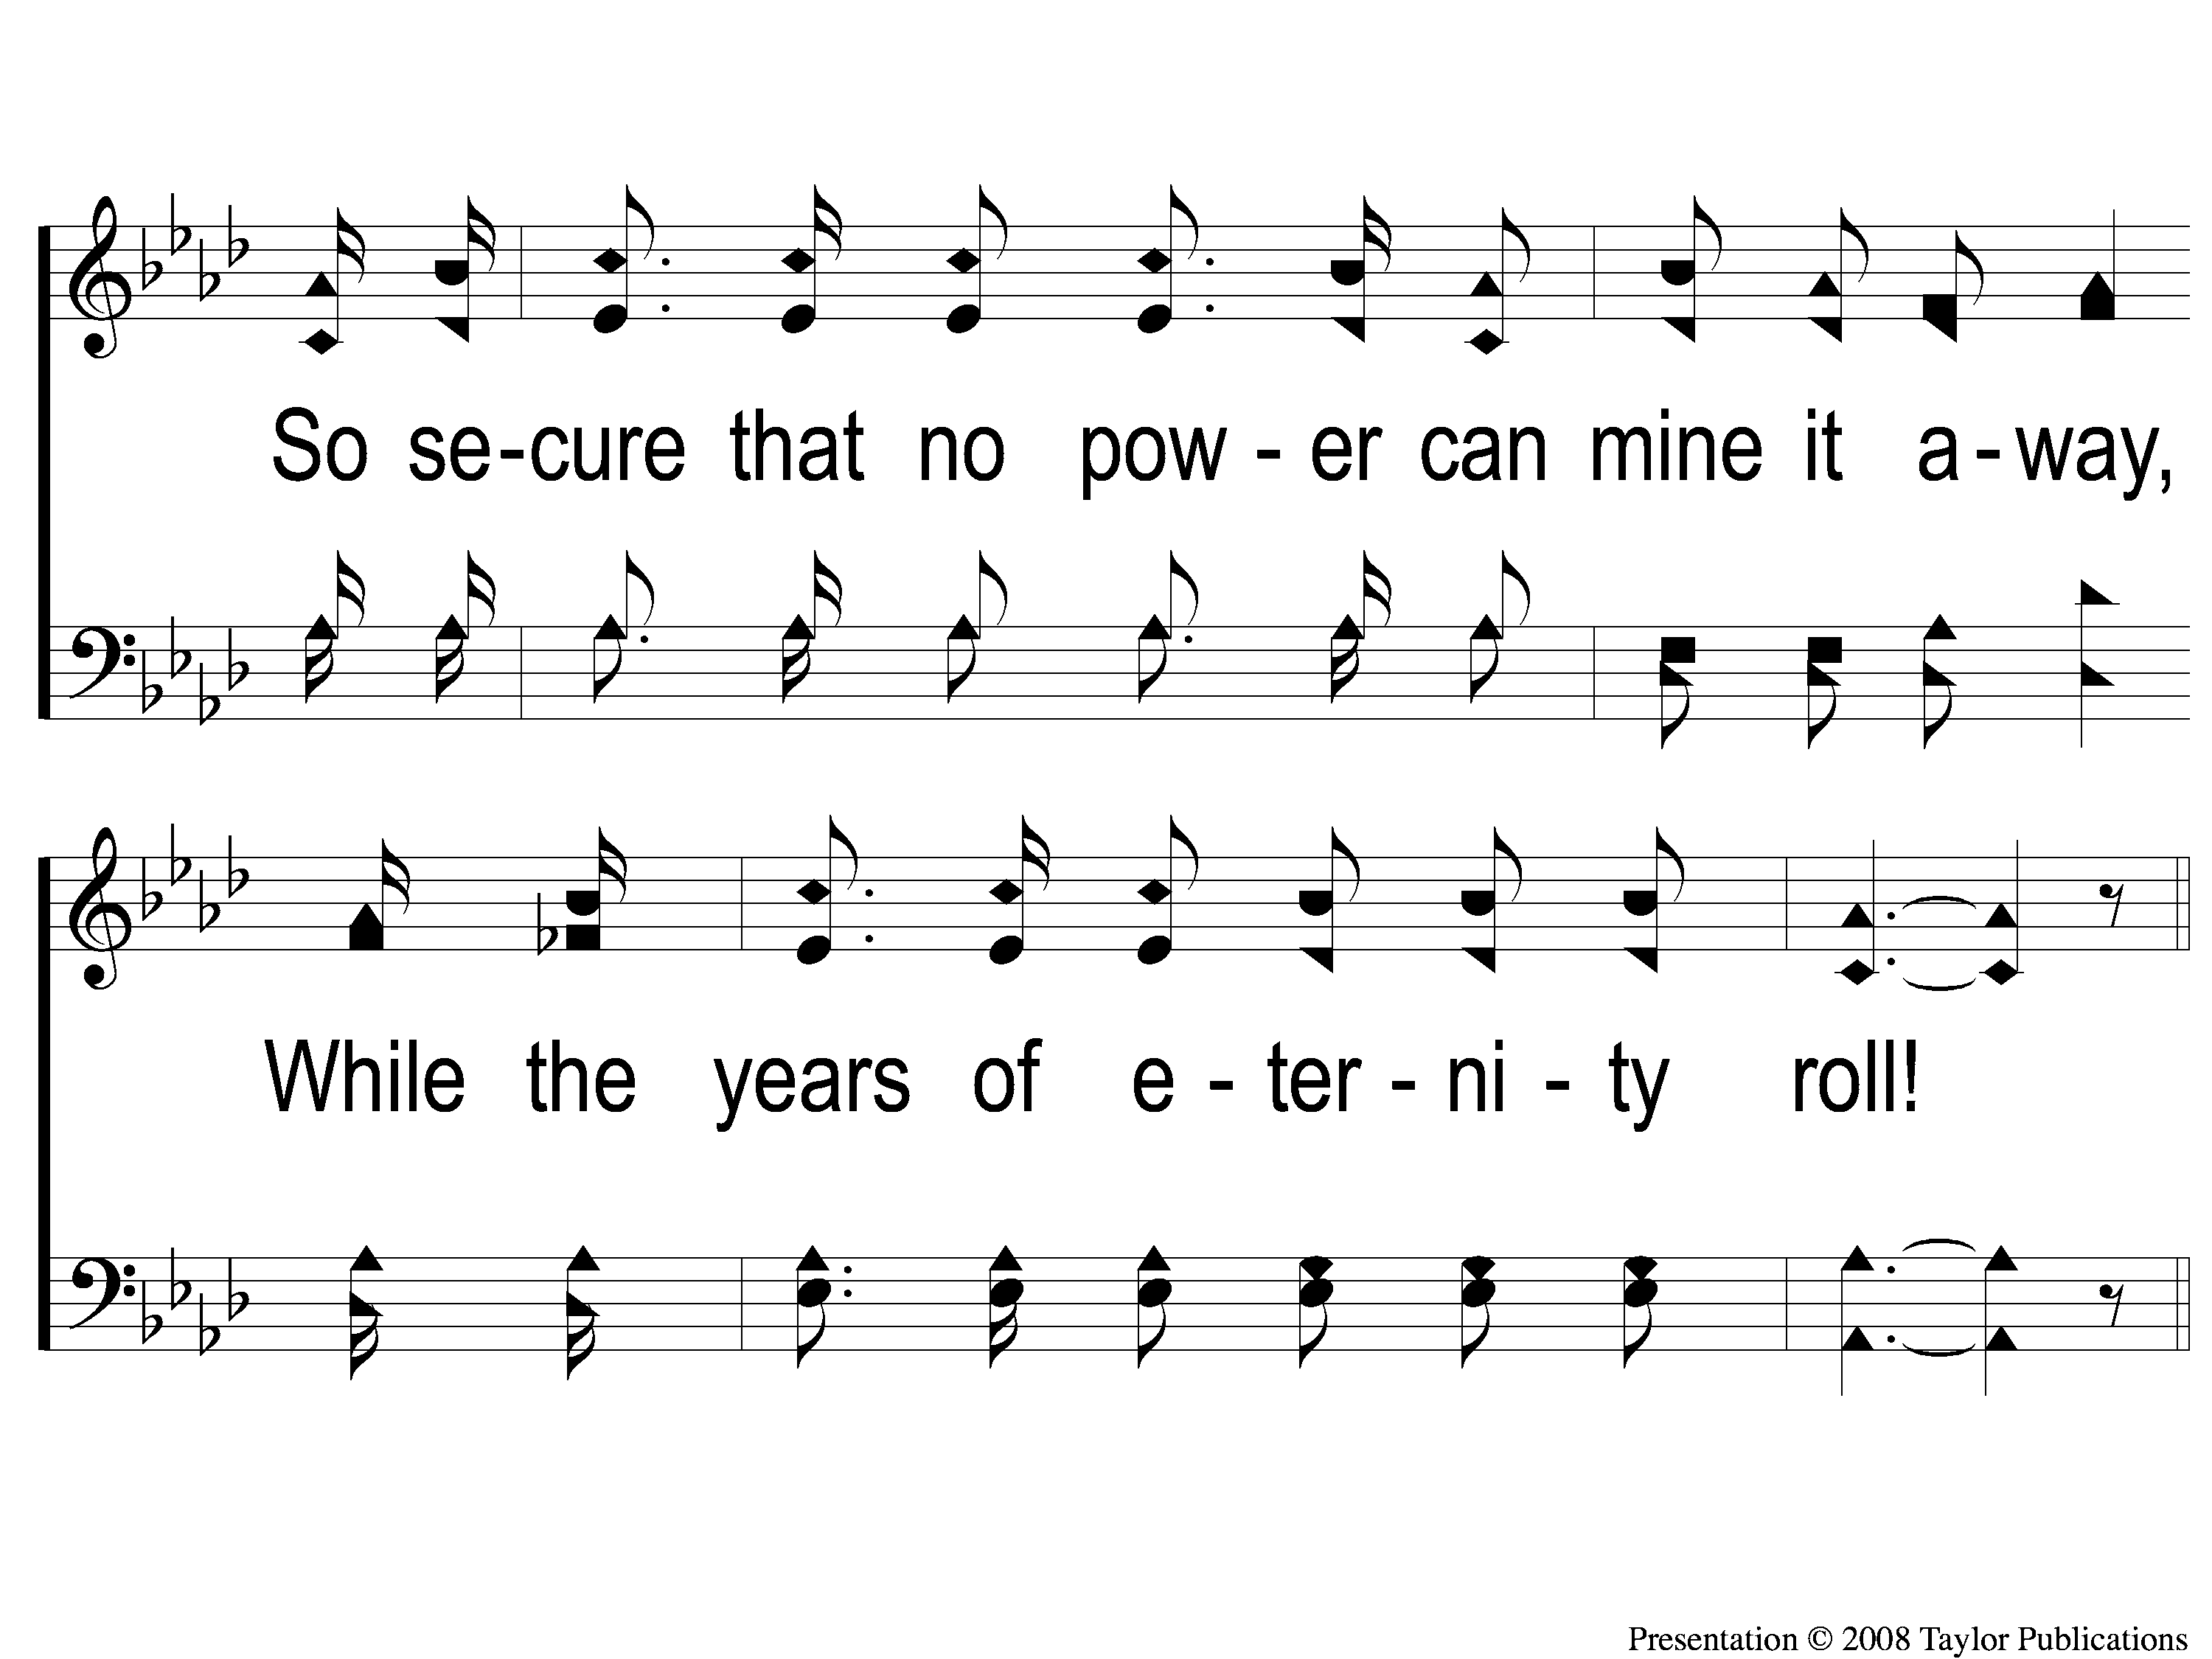
2-2 Far Away In The Depths
Far Away In The Depths
101

Slide 7
C-1 Far Away In The Depths
Far Away In The Depths
101

Slide 8
C-2 Far Away In The Depths
Far Away In The Depths
101

Slide 9
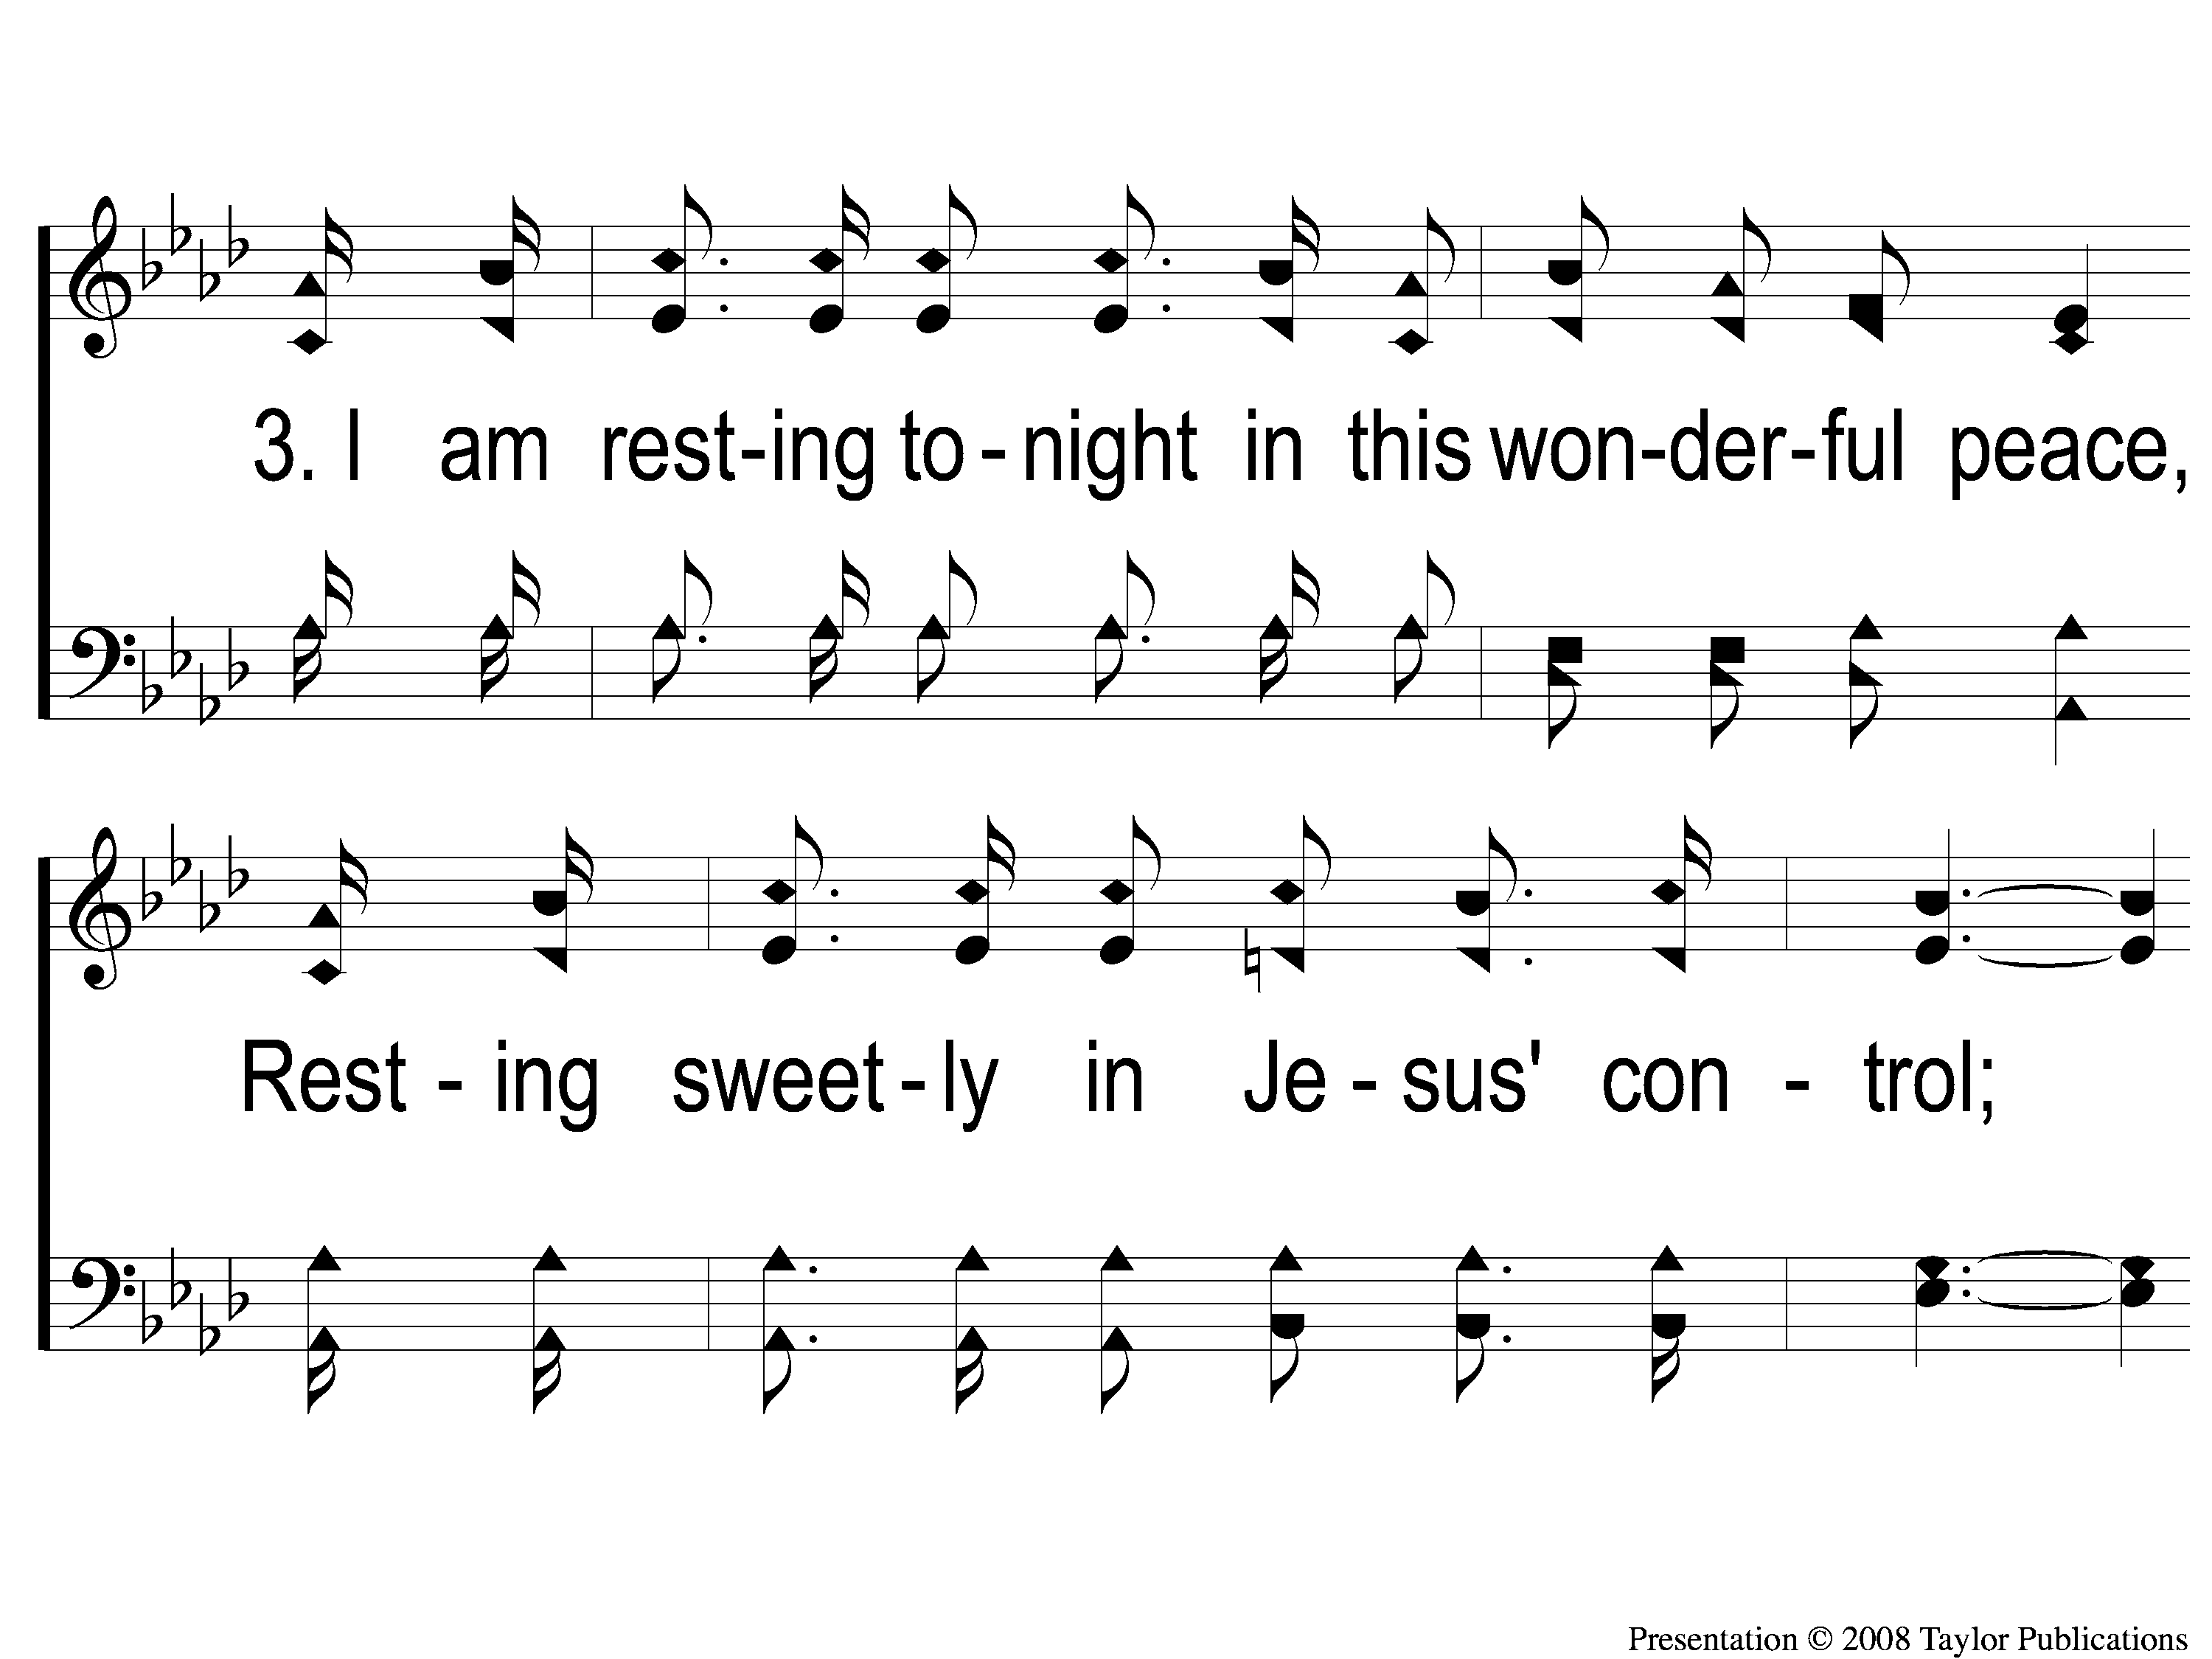
3-1 Far Away In The Depths
Far Away In The Depths
101

Slide 10
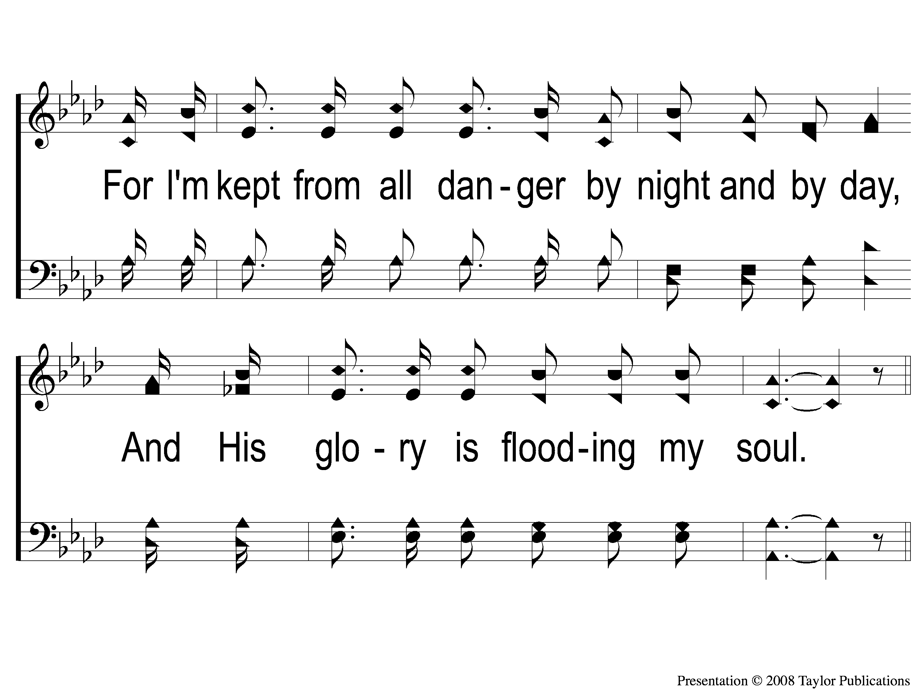
3-2 Far Away In The Depths
Far Away In The Depths
101

Slide 11
C-1 Far Away In The Depths
Far Away In The Depths
101

Slide 12
C-2 Far Away In The Depths
Far Away In The Depths
101

Slide 13
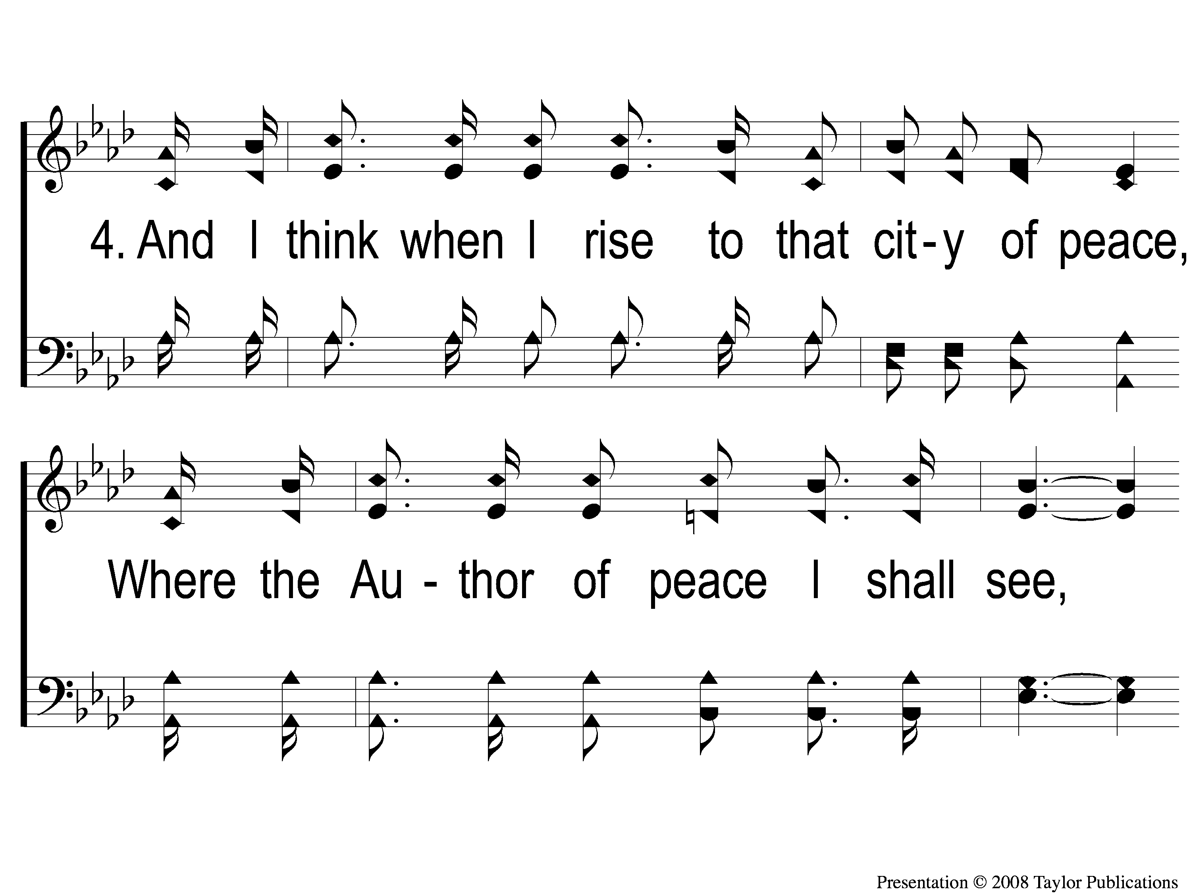
4-1 Far Away In The Depths
Far Away In The Depths
101

Slide 14
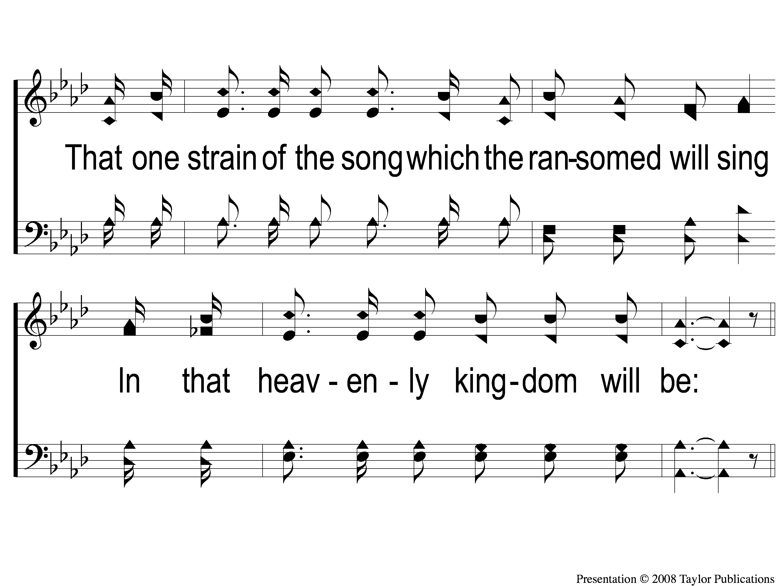
4-2 Far Away In The Depths
Far Away In The Depths
101

Slide 15
C-1 Far Away In The Depths
Far Away In The Depths
101

Slide 16
C-2 Far Away In The Depths
Far Away In The Depths
101

